Slide 1

Comprehensive Digital Marketing Project Work Of Apollo Hospitals

Slide 2

Part 1: Brand study, Competitor Analysis & Buyer’s/Audience’s Persona
● Research Brand Identity: Study the brand's mission, values, vision, and unique selling propositions (USPs).
● LOGO
Founder :
Dr.Prathap C Reddy
• Founded Year :
1983
• Official Website :
• www.apollohospitals.com

Slide 3


Mission/Values:
Our mission is to bring healthcare of international standards with in the reach of every individual. We are committed to the achievement and maintenance of excellence in education, research and healthcare for the benefit of humanity.
World Class Excellence: ...
Some of the core values that Apollo Hospitals upholds include:
Pioneering Attitude: Stay ahead of the curve by constantly creating innovative solutions for the wellbeing of our patients and society as a whole.
Proactive Involvement: Always look for ways to add value in everything we do by going the extra mile.

Slide 4
World Class Excellence: ...
Trustworthy Spirit: ..
Compassionate Care:
Vision: Apollo’s vision for the next phase of development is to “Touch a billion lives”
Unique Selling Proposition (USP): Apollo Hospitals value proposition lies in the brand name which has earned the trust of the people through its services that they have been providing since 1938, all over the world. Apollo Ranchi, along with brand name also exudes value for patient in terms of the low cost model of treatment .
Apollo pharmacy is a part of Apollo hospitals- Asia’s largest healthcare group.
The first hospital was started in 1983 by Dr.Pratap Singh Reddy(Chairman) in Chennai. It was 150 beds hospital. Now in Asia there more than 1000 Apollo pharmacy retail outlet are present.
In Jaipur the project was came in May 2002 and there were 20 locations selected across the city and the 1st chemist shop was open in Malviya Nagar , Kabir Marg in June 2002 And now there are total 28 retail shops in Jaipur.

Slide 5
It's important to note that the provided text is limited and may not cover all aspects of Apollo Hospital brand identity comprehensively. For a more in-depth analysis, further research on Apollo Hospital history, marketing strategies, and recent developments would be necessary.
Part 1: Brand study, Competitor Analysis & Buyer’s/Audience’s Persona
Analyze brand messaging : Apollo hospitals is the leading multispecialty health care unit with best in class treatments for cancer, knee replacements, liver transplant, heart, diabetes, kidney etc.
Apollo Hospitals’ Billion Hearts Beating Campaign wins the “Best Marketing Campaign of the Year” Award at the World Brand Congress 2010
Examine The Brand Tagline : However, it's essential to note that brand messaging and taglines can change over time, so it's recommended to refer to the latest information from official sources or conduct a search to get up-to-date and accurate information about Apollo hospital current tagline and brand messaging

Slide 6
Part 1: Brand study, Competitor Analysis & Buyer’s/Audience’s Persona
● Competitor Analysis: Select three competitors operating in the same industry or niche as the chosen brand, examine their USPs and online communication.
Competitor 1: https://www.max health care.in
Max health care is India’s leading providers of world class healthcare services. with 4800+ doctors & a network of 17 hospitals in India, we offer treatment across 29 specialties.
Competitor 2: http://www.vaidam.com
Vaidam health connects you with the best doctors and hospitals in india for treatment at affordable price. Vaidam also assists in travel and stay along with 24x7 care for patient and attendant.

Slide 7
Competitor 3 : https://www. West Suburban Medical Center .com
West Suburban Medical Center provides medical and surgical services. Louis Pasteur is a health care centre that provides medical services. Dactari Total Health Care Solutions is a provider of hospital management systems. New Mowasat Hospital is a healthcare services provider.
Services that are provided exclusively by the Apollo Hospitals. Which can treat the quality of the treatment.
Website Design and User Experience: Assess the website layout, navigation, and overall user-friendliness.
Content Strategy: Evaluate the type of content they publish and how often (articles, videos, infographics, etc.).
Social Media Presence: Check their engagement levels, number of followers, and frequency of posts.
Brand Messaging: Analyze their tone, voice, and consistency in branding across different platforms.
Customer Interaction: Look for how they handle customer inquiries, complaints, and feedback.

Slide 8

Strengths : Apollo Hospitals is a renowned and well-recognized brand name in the healthcare industry by offering quality services to its customers and patients
Weaknesses : A chain network of Hospitals and pharmacies is an easy-to-launch business model that Apollo Hospitals is following it.
Opportunities : The cost of healthcare is increasing in Western countries. It presents a great opportunity for Apollo Hospitals to expand its business operations in western countries
Threats : World’s leading political powers like China, the US, and Europe have got conflicting relations when it comes to trade policies.

Slide 9

Remember that competitor analysis is an ongoing process, and it's crucial to keep track of any changes or developments in the market landscape. Conducting a thorough competitor analysis can provide valuable insights to help businesses refine their strategies and stay competitive in the market.
Part 1: Brand study, Competitor Analysis & Buyer’s/Audience’s Persona
Buyer's/Audience's Persona: Clearly define the target audience for the chosen brand. Consider demographics, psychographics, behaviors, and interests.

Slide 10
As an AI language model, I don't have access to external files or the internet, so I can't provide a PDF of Apollo Hospital. However, I can help you define the target audience for the Apollo Hospital brand based on the information available up to my last update .
Target Audience for Apollo Hospital:
Demographics:
Age : Apollo Hospitals aim at providing health care facilities to the people of all age groups i.e is , An infant to a very senior citizen.
Gender : Apollo Hospitals offer services to all genders irrespective of any discrimination.
Location : Apollo Hospitals operate in all major cities connecting all the towns , with its headquarters at Chennai.
Psychographics:
Cultural identity : Apollo values ensure hospitality , accountability , diversity to everyone , defining not only as individuals but also a families.
Value oriented : Safety , care and trust there are the core values at Apollo , and factor into every decision they make on a daily basis.

Slide 11
Premium for super treatment
Behaviours
Brand loyalty : One Apollo loyalty program is the flagship heathcare loyalty program of one Apollo digital under Apollo Hospitals Enterprise Limited (AHEL) in India.
Honest and Ethical conduct : It is the policy of the company to conduct its business in accordance with all applicable laws and regulations of the jurisdiction.
Disclosure of interest : It is an obligation of every director to conduct its business and to disclose nature of his/her interest or concern in any material transaction.
Interests :
Healthier humanity : The Apollo foundation strives towards healthier humanity through a number of philanthrophic ventures and collaborations.
corporate social Responsibility : Apollo Hospitals volunteers for any & these three programmes -
Total Health : Total Health is the CSR initiative of Apollo Hospitals Enterprise limited covering programes such as physical, mental, social, ecological & spiritual health.
Billion Hearts Beating: The Billion Hearts Beating Foundation is a not for profit organization that aims to touch as billion lives through its services rooted in empathy, dignity and respect.
SachiI: Saving A child's Health initiative is as not for profit organization equal right based on the philosophy that every quality child has an equal right to access quality healthcare.

Slide 12
“Faith helps drive all action. I believe in in three P’s :
Purity , that your motivation is not for yourself , persistence, Working hard & continuously on problems , faith fortifies people in different ways"
-Dr prathap c Reddy
Founder – chair person, Apollo Group
Part 2: SEO & Keyword Research
SEO Audit : Now that you’ve learned how to show up in search results, let’s determine which strategic keywords to target in your website’s content, and how to craft that content to satisfy both users and search engines. The power of keyword research lies in better understanding your target market and how they are searching for your content, services, or products. In this chapter, you’ll get tools and strategies for uncovering that information, as well as learn tactics that’ll help you avoid keyword research foibles and build strong content. Once you uncover how your target audience is searching for your content, you begin to uncover a whole new world of strategic SEO!
Key word Research: Keyword research is a practice search engine optimization professionals used to find and research search terms that users enter into search engines when looking for products, services, or general information keywords are related to queries that are asked by users in search engines.

Slide 13
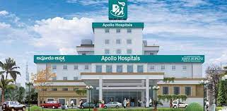
On Page optimization: refers to all measures taken by SEOs within the website to improve the ranking of a site in search engineer result pages. These measures are related to content and HTML source code of a page, e.g., meta tags, keyword Exc
Apollo Hospital : Established by Dr Prathap C Reddy in 1983, Apollo Healthcare has a robust presence across the healthcare ecosystem. From routine wellness & preventive health care to innovative life-saving treatments and diagnostic services, Apollo Hospitals has touched more than 200 million lives from over 120 countries. Apollo Group constitutes the best hospital in India with over 10,000 beds across 73 hospitals, 5000+ pharmacies, over 300 clinics, 1100+ diagnostic centres and 200+ Telemedicine units.

Slide 14
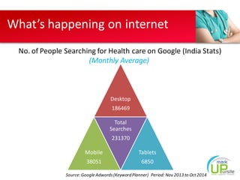
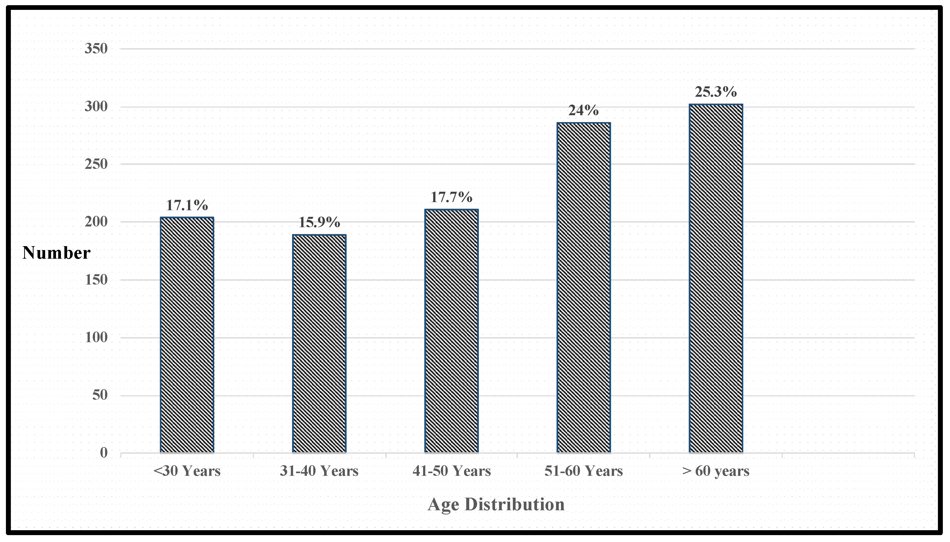

Key word research :

Slide 15


Slide 16


Slide 17
Part 3: Content Ideas and Marketing Strategies
● Content Idea Generation & Strategy: Create a content calendar for the remaining month of July by brainstorming content themes, exploring various formats like blog posts, videos, infographics, podcasts, and interactive quizzes, and scheduling publication dates mainly on Facebook & Instagram.
And include the strategy, aim and the idea behind these posts and story
Content Calendar Example (Try creating a table for the month of July)

Slide 18
Content Idea Generation & Strategy: Strategy and Aim:
Engagement & Fun: The content calendar starts with an infographic on Apollo Hospital Day to engage followers playfully, encouraging them to interact by sharing their flavours.
2. Brand Story telling: The video on July 5th shares Apollo Hospital, creating an emotional connection with the brand and fostering loyalty.
3. Education & Awareness: The blog post on July 10th aims to educate the audience about health services , showcasing Apollo hospital commitment to sustainability.
4. CSR & Impact: The podcast on July 15th highlights Apollo hospital corporate social responsibility initiatives, enhancing the brand's positive image.
5. User-Generated Content: The interactive quiz on July 20th generates user participation, building a sense of community around the brand.
6. Product Showcase: The behind-the-scenes video on July 25th showcases the quality and craftsmanship behind Apollo hospital.
7. Healthy Living: The infographic on July 30th provides health tips as part of a wholesome lifestyle.

Slide 19


Idea Behind Apollo Hospital Content :
Apollo Hospitals was established in 1983 by Dr. Prathap C Reddy, renowned as the architect of modern healthcare in India. As the nation's first corporate hospital, Apollo Hospitals is acclaimed for pioneering the private healthcare revolution in the country. Apollo Hospital, Bannerghatta Road, Bangalore is one of the best & well-known multi speciality hospitals available in Karnataka. This hospital has all types of rooms and suites, advanced operation theaters, an in-house pharmacy, and many more facilities.

Slide 20
July 2023
Sunday | Monday | Tuesday | Wednesday | Thursday | Friday | Saturday
 |  |  |  |  |  | 1
2 | 3 | 4 | 5 | 6 | 7 | 8
9 | 10 | 11 | 12 | 13 | 14 | 15
16 | 17 | 18 | 19 | 20 | 21 | 22
23 | 24 | 25 | 26 | 27 | 28 | 29

Slide 21
July 2023
Sunday | Monday | Tuesday | Wednesday | Thursday | Friday | Saturday
 |  |  |  |  |  | 1
2 | 3 | 4 | 5 | 6 | 7 | 8
9 | 10 | 11 | 12 | 13 | 14 | 15
16 | 17 10am-12pm Apollo hospital identity | 18 10am-12pm Key word research | 19 10am-12pm Competitor analysis for Apollo hospital | 20 10am-12pm SEO audit for Apollo hospital | 21 10am-12pm Instagram quiz post for Apollo hospital | 22 10am-12pm Apollo hospital ad video
23 | 24 | 25 | 26 | 27 | 28 | 29
30 | 31

Slide 22
Part 3: Content Ideas and Marketing Strategies
● Reflect on the content ideas and marketing strategies process, discussing the challenges encountered and lessons learned.
which strategy does Apollo Hospital use
Apollo Hospital uses demographic and psychographic segmentation strategies with variables such as age, gender, income, region, and marital status. Apollo Hospital uses demographic and psychographic segmentation strategies with variables such as age, gender, income, region, and marital status.
According to Reddy, Apollo will reach its occupancy goal under several strategies, reducing dependency on institutional patients, prioritising worldwide patients, increasing doctor recruitment, and improving the payor mix.
What is the aim of Apollo hospitals :
Apollo Hospitals began its operations as a specialized Intensive Care Unit (ICU). Their main motto is “Saving & Enriching Lives”. They have achieved some unique and complex surgeries and are a trusted multispeciality hospital in and around Bangalore city.

Slide 23
Objectives of Apollo Hospital :
“Our mission is to bring Healthcare of International standards within the reach of every individual. We are committed to the achievement and maintenance of excellence in Education, Research and Healthcare for the benefit of humanity”.
Part 4: Content Creation and Curation (Post creations, Designs/Video Editing, Ad Campaigns over Social Media and Email Ideation and Creation)
Post Creation :
Select Content Categories:
Identify three different content formats relevant to the chosen topic or industry. Research and Brainstorm: Research trending topics, industry news, or audience interests within each category. Brainstorm ideas for social media posts that align with each category. Do note that 1 content format has to be video and additionally 3 stories/status are to be created.

Slide 24

Format 1 : Creative
AIM : Brand awareness & reach
DATE :29-09-2017
IDEA : To create a story on the Apollo Hospital in different social media platforms
TOPIC : Apollo Hospital ad
Format 2 : Video
AIM :To promote newly launched Apollo Hospital branches
DATE : 20-07-2023
IDEA : Apollo hospital has launched new Apollo hospital braches and we make a video on the benefits of the Apollo hospital

Slide 25
Part 4: Content Creation and Curation (Post creations, Designs/Video Editing, Ad Campaigns over Social Media and Email Ideation and Creation)
Instagram Story
Utilize the Stories feature on Instagram for three consecutive days. Share behind-the-scenes glimpses, polls, quizzes, or sneak peeks etc to encourage audience participation. Once uploaded use the story highlight feature on Instagram and save the 3 story with an appropriate name for each.
Note: Once done monitor the performance of the posts and Stories using the insight tool and analyze the engagement metrics (likes, comments, shares, impressions, etc.). Based on the analysis, mention the strategies and areas for improvement.

Slide 26
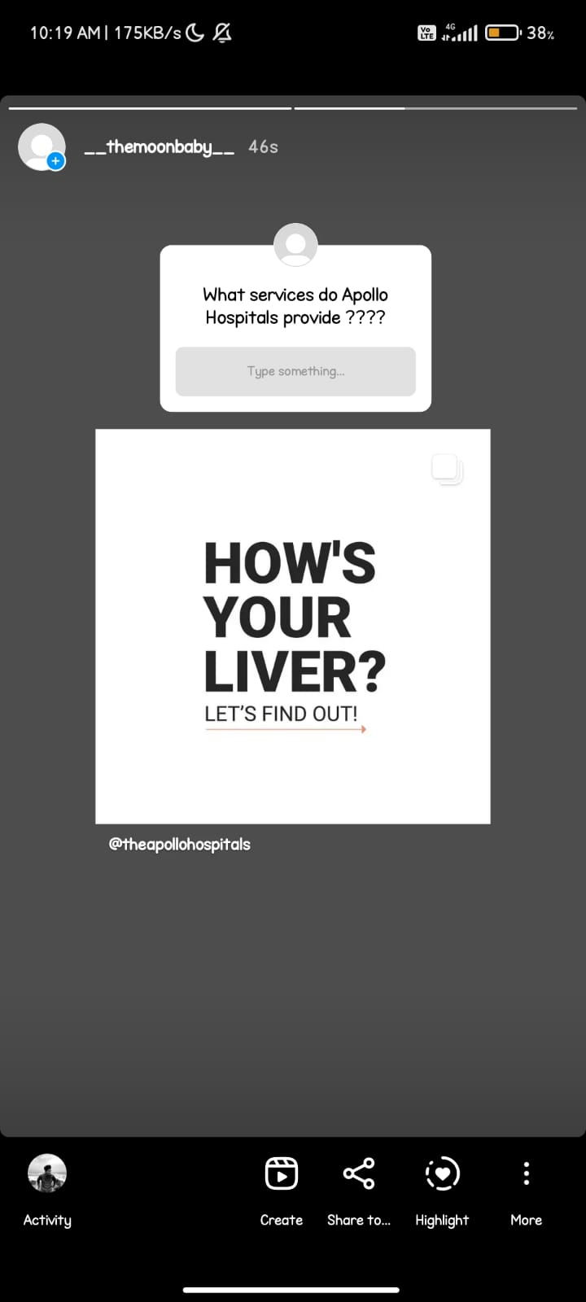
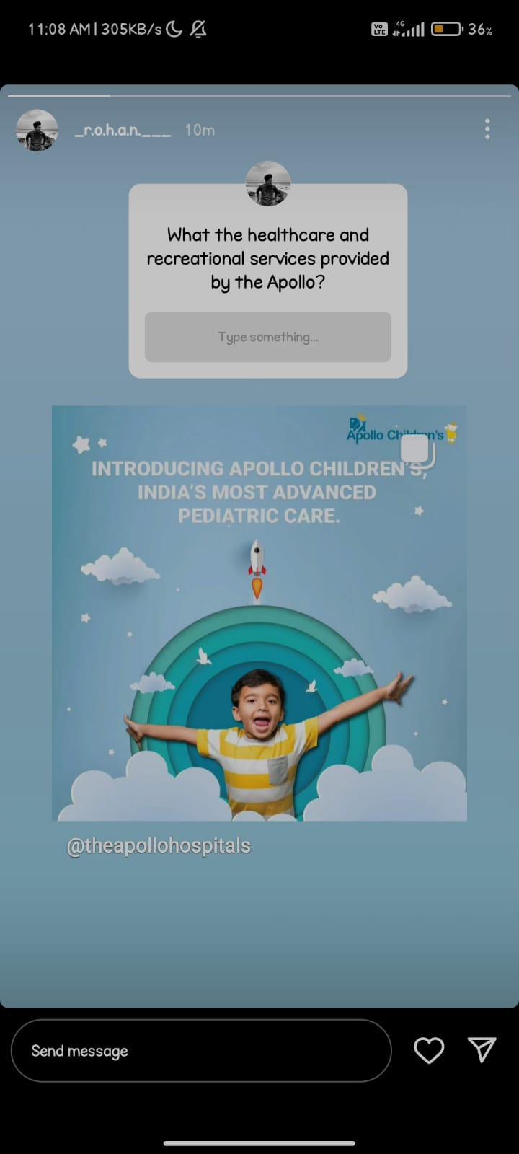


Slide 27
Part 4: Content Creation and Curation (Post creations, Designs/Video Editing, Ad Campaigns over Social Media and Email Ideation and Creation)
Designs/Video Editing
● Design Tools Familiarization (use Canva for creating visually appealing graphics) ● Video Creation: Utilize VN or any video editor of your choice to create videos related to the chosen topic.
Apollo Hospitals Enterprise Limited is an Indian multinational healthcare group headquartered in Chennai. It is the largest hospital chain in India, with a network of 71 owned and managed hospitals.^{[5][6]} Along with the eponymous hospital chain, the company also operates pharmacies, primary care and diagnostic centres, telehealth clinics, and digital healthcare services among others through its subsidiaries
APOLLO HOSPITAL AD VIDEO LINK
https://youtu.be/D0lzmDmWA3Q
By Using Canva, & other video editing apps are used to develop the video for the AMUL AD. And uploaded in different platforms to reach them.

Slide 28
VIDEO

Slide 29

MAKING THE VIDEO FOR APOLLO HOSPITAL AD
The video production process consists of 3 main steps: pre-production, which is the planning stage for mapping out your strategy and script for the video, production is the phase in which the video is shot, and finally post-production, which involves editing the video, adding music and other effects. Let’s walk through the process step by step.
*Firstly collect information about APOLLO HOSPITAL through official websites of Apollo Hospital
*Secondly collect images and other details about them and ready to plan the process *Thirdly from the collected data ,make the video by using different editing apps, sites

Slide 30
Part 4: Content Creation and Curation (Post creations, Designs/Video Editing, Ad Campaigns over Social Media and Email Ideation and Creation)
Social Media Ad Campaigns
Ad Campaigns over Social Media:
Come up with 3 ad campaigns each covering one of the mentioned goals: brand awareness, driving website traffic, or generating leads
https://www.instagram.com/p/CuI8J3aKrl1/?hl=en
https://www.instagram.com/reel/Ck-7RjcqAZM/?hl=en
https://www.instagram.com/reel/CjnYu8DO2HJ/?hl=en

Slide 31

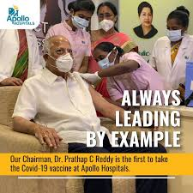

Slide 32
Part 4: Content Creation and Curation (Post creations, Designs/Video Editing, Ad Campaigns over Social Media and Email Ideation and Creation)
For every campaign clearly define:
● Advertising Goals: increasing brand awareness, driving website traffic, or generating leads.
● Audience Targeting: Define the target audience for the ad campaigns based on demographics, interests, and behavior.
● Ad Creation: Create visually appealing ad creatives, compelling ad copy and relevant call- to
-action.
Apollo Health and Lifestyle :
Apollo Health and Lifestyle is the primary and secondary care arm of the group which operates multi-specialty clinics under Apollo Clinics, diagnostics and pathology labs under Apollo Diagnostics, diabetes clinics under Apollo Sugar, dental hospitals under Apollo White, dialysis centres under Apollo Dialysis, minimally invasive surgical hospitals under Apollo Spectra, women/children hospitals under Apollo Cradle, and fertility clinics under Apollo Fertility.

Slide 33
Part 4: Content Creation and Curation (Post creations, Designs/Video Editing, Ad Campaigns over Social Media and Email Ideation and Creation)
Email Ad Campaigns
Ad Campaigns for email marketing:
Come up with 2 email ad campaigns with the mentioned goals: brand awareness & generating leads

Slide 34

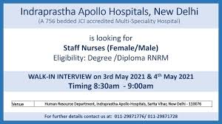
Email Ad Campaign 1 - Brand Awareness
(insert emailer image)
https://youtu.be/CSKK9Hum440

Slide 35
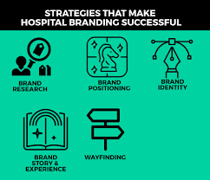

Slide 36
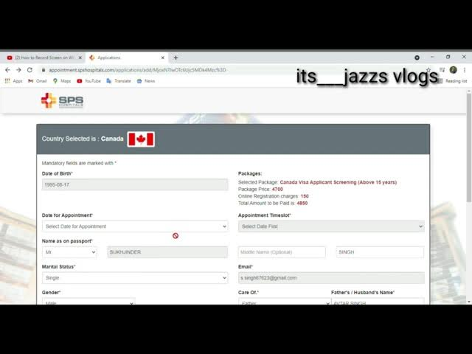
Email Ad Campaign 2 - Lead Generation
(insert emailer image)
https://www.youtube.com/shorts/io4WgwvIgzA?feature=share

Slide 37
Part 4: Content Creation and Curation (Post creations, Designs/Video Editing, Ad Campaigns over Social Media and Email Ideation and Creation)
● Reflect on the content creation and curation process, discussing the challenges faced and lessons learned.
We learnt how to create ad campaigns and video designing and gained practical knowledge in digital marketing.
We gradually learnt how to gain loyal customers and build brand image by attracting target audience.
We convey our sincere regards to our project mentors, tutors & our college staff for their guidance throughout the project

